Slide 1
Deep Dive into Vanilla Neural Networks

Slide 2

Terms to remember
▣ Gradient
▣ Differentiation
▣ Trainable variables Model parameters which can be trained in order to minimize the loss(Ex: Weights and biases)
▣ Partial derivative Instantaneous rate of change for functions of multiple variables
▣ NonLinear Function Having a slope which varies between points

Slide 3
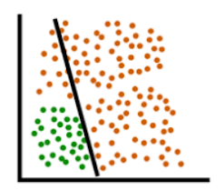
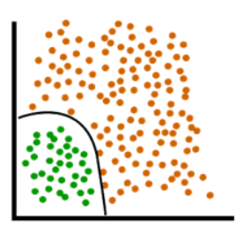
Neural Networks: Idea
▣ Chain together non-linear functions
▣ Have lots of parameters that can be adjusted
▣ These “weights” determine the model function
Linear Boundary Non-Linear Boundary

Slide 4
Neural Networks: Let's Play
https://playground.tensorflow.org/

Slide 5
Importance of Non-linear Functions in Neural Nets
▣ Nonlinear functions have a slope that varies between points
▣ Maps input variable with output of the network
▣ Without a non-linear activation function in your NN(neural network), no matter how many layers it had, it will behave just like a single-layer perceptron, because summing these layers would give you just another linear function

Slide 6
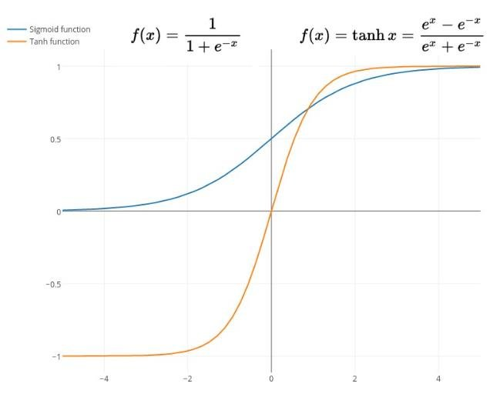
Varying slope in NonLinear Functions

Slide 7
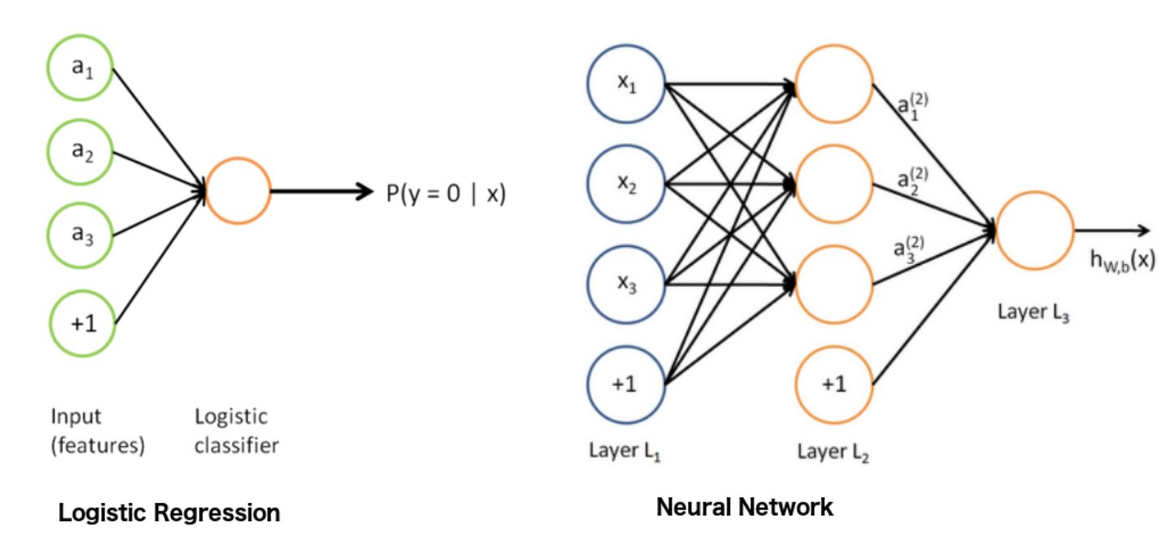
Why Neural Networks ?
Better decision boundaries for classification tasks. Works better than traditional ML if data is large.

Slide 8
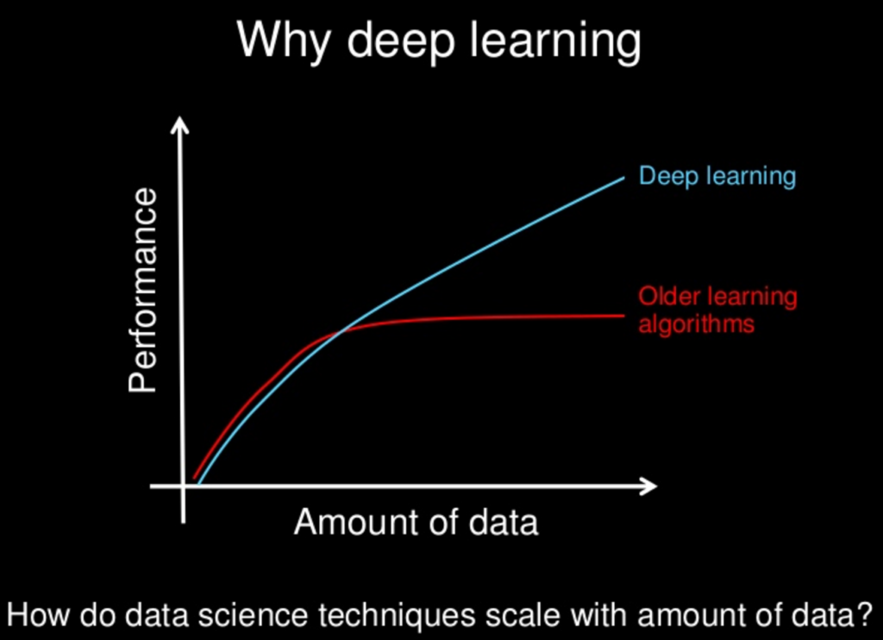
Why Neural Networks ?
With increase in data, there is increase in the performance of the algorithm.
The same is not true for other Machine learning algorithms, as they reach a plateau after a certain amount of data is provided
Deep Learning is not a new technique, it has been around for decades, but it has only gained popularity in the last 15 years
Reason Being- Enormous increase in availability of data.

Slide 9
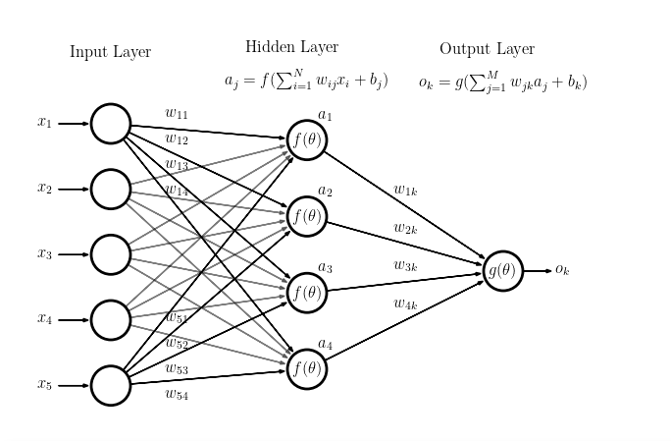
Neural Networks: Idea

Slide 10
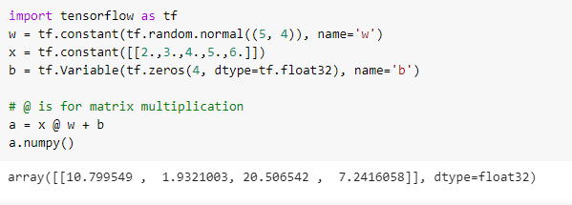
Neural Networks: Idea
Vectorized operations are much faster than traditional operations.

Slide 11
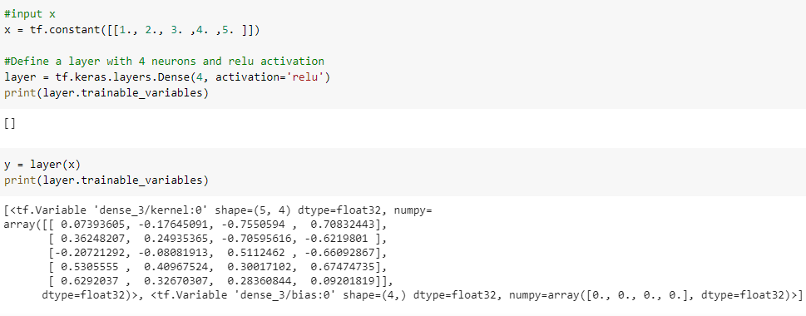
Neural Networks: Idea

Slide 12
Feed forward neural network
_{a}(2) _{a}(3)
_{W}(1) _{W}(2) _{W}(3)
_{a}(4)
x₁
ŷ
x₂
+1
+1
+1
_{l} (1)
input
_{l} (2)
hidden 1
_{l} (3)
hidden 2
_{l} (4)
output

Slide 13
_{a}(2)
_{a}(3)
_{a}(4)
_{W}(1)
_{W}(2)
_{W}(3)
σ
σ
x₁
SM
ŷ
σ
σ
x₂
SM
σ
σ
+1
SM
+1
+1
x_{i}: input value ŷ: output vector
σ: sigmoid (logistic) function SM: Softmax function
+1: bias (constant) unit
a^{(l)}: activation vector for layer l
W^{(l)}: weight matrix for layer l
_{z}(l):
input into layer l

Slide 14
Layer 1
_{a}(2)
_{a}(3)
_{a}(4)
_{W}(1)
_{W}(2)
_{W}(3)
σ
σ
x₁
SM
ŷ
σ
σ
x₂
SM
σ
σ
+1
SM
+1
+1
x_{i}: input value ŷ: output vector
σ: sigmoid (logistic) function SM: Softmax function
+1: bias (constant) unit
a^{(l)}: activation vector for layer l
W^{(l)}: weight matrix for layer l
_{z}(l):
input into layer l

Slide 15
Layer 2
_{a}(2)
_{a}(3)
_{a}(4)
_{W}(1)
_{W}(2)
_{W}(3)
σ
σ
x₁
SM
ŷ
σ
σ
x₂
SM
σ
σ
+1
SM
+1
+1
x_{i}: input value ŷ: output vector
σ: sigmoid (logistic) function SM: Softmax function
+1: bias (constant) unit
a^{(l)}: activation vector for layer l
W^{(l)}: weight matrix for layer l
_{z}(l):
input into layer l

Slide 16
Layer 3
_{a}(2)
_{a}(3)
_{a}(4)
_{W}(1)
_{W}(2)
_{W}(3)
σ
σ
x₁
SM
ŷ
σ
σ
x₂
SM
σ
σ
+1
SM
+1
+1
x_{i}: input value ŷ: output vector
σ: sigmoid (logistic) function SM: Softmax function
+1: bias (constant) unit
a^{(l)}: activation vector for layer l
W^{(l)}: weight matrix for layer l
_{z}(l):
input into layer l

Slide 17
Layer 4
_{a}(2)
_{a}(3)
_{a}(4)
_{W}(1)
_{W}(2)
_{W}(3)
σ
σ
x₁
SM
ŷ
σ
σ
x₂
SM
σ
σ
+1
SM
+1
+1
x_{i}: input value ŷ: output vector
σ: sigmoid (logistic) function SM: Softmax function
+1: bias (constant) unit
a^{(l)}: activation vector for layer l
W^{(l)}: weight matrix for layer l
_{z}(l):
input into layer l

Slide 18
_{a}(2)
_{a}(3)
_{a}(4)
_{W}(1)
_{W}(2)
_{W}(3)
σ
σ
x₁
SM
ŷ
σ
σ
x₂
SM
σ
σ
+1
SM
+1
+1
Biases (constant units)
x_{i}: input value σ: sigmoid (logistic) function ŷ: output vector SM: Softmax function
+1: bias (constant) unit
a^{(l)}: activation vector for layer l
W^{(l)}: weight matrix for layer l
_{z}(l):
input into layer l

Slide 19
_{a}(2)
_{a}(3)
_{a}(4)
Input
_{W}(1)
_{W}(2)
_{W}(3)
σ
σ
x₁
SM
ŷ
σ
σ
x₂
SM
σ
σ
+1
SM
+1
+1
x_{i}: input value ŷ: output vector
σ: sigmoid (logistic) function SM: Softmax function
+1: bias (constant) unit
a^{(l)}: activation vector for layer l
W^{(l)}: weight matrix for layer l
_{z}(l):
input into layer l

Slide 20
Weight matrices
_{a}(2)
_{a}(3)
_{a}(4)
_{W}(1)
_{W}(2)
_{W}(3)
σ
σ
x₁
SM
ŷ
σ
σ
x₂
SM
σ
σ
+1
SM
+1
+1
x_{i}: input value ŷ: output vector
σ: sigmoid (logistic) function SM: Softmax function
+1: bias (constant) unit
a^{(l)}: activation vector for layer l
W^{(l)}: weight matrix for layer l
_{z}(l):
input into layer l

Slide 21
_{z}(l) _{= W}(l-1)_{a}(l-1) _{+ b}(l-1)
Layer inputs, z^{(l)}
_{a}(2)
_{a}(3)
_{a}(4)
_{W}(1)
_{W}(2)
_{W}(3)
σ
σ
x₁
SM
ŷ
σ
σ
x₂
SM
σ
σ
+1
SM
+1
+1
x_{i}: input value ŷ: output vector
σ: sigmoid (logistic) function SM: Softmax function
+1: bias (constant) unit
a^{(l)}: activation vector for layer l
W^{(l)}: weight matrix for layer l
_{z}(l):
input into layer l

Slide 22
Activation vectors
_{a}(2)
_{a}(3)
_{a}(4)
_{W}(1)
_{W}(2)
_{W}(3)
σ
σ
x₁
SM
ŷ
σ
σ
x₂
SM
σ
σ
+1
SM
+1
+1
x_{i}: input value ŷ: output vector
σ: sigmoid (logistic) function SM: Softmax function
+1: bias (constant) unit
a^{(l)}: activation vector for layer l
W^{(l)}: weight matrix for layer l
_{z}(l):
input into layer l

Slide 23
Sigmoid activation function
_{a}(2) _{a}(3)
_{W}(1) _{W}(2)
σ σ
_{a}(4)
_{W}(3)
x₁
SM
ŷ
σ
σ
x₂
SM
σ
σ
+1
SM
+1
+1
x_{i}: input value ŷ: output vector
σ: sigmoid (logistic) function SM: Softmax function
+1: bias (constant) unit
a^{(l)}: activation vector for layer l
W^{(l)}: weight matrix for layer l
_{z}(l):
input into layer l

Slide 24
Softmax activation function
_{a}(2)
_{a}(3) _{a}(4)
_{W}(1)
_{W}(2)
_{W}(3)
σ
σ
x₁
SM
ŷ
σ
σ
x₂
SM
σ
σ
+1
SM
+1
+1
x_{i}: input value ŷ: output vector
σ: sigmoid (logistic) function SM: Softmax function
+1: bias (constant) unit
a^{(l)}: activation vector for layer l
W^{(l)}: weight matrix for layer l
_{z}(l):
input into layer l

Slide 25
_{a}(2)
_{a}(3)
_{a}(4)
Output
_{W}(1)
_{W}(2)
_{W}(3)
σ
σ
x₁
SM
ŷ
σ
σ
x₂
SM
σ
σ
+1
SM
+1
+1
x_{i}: input value ŷ: output vector
σ: sigmoid (logistic) function SM: Softmax function
+1: bias (constant) unit
a^{(l)}: activation vector for layer l
W^{(l)}: weight matrix for layer l
_{z}(l):
input into layer l

Slide 26
Forward Propagation
_{a}(2)
_{a}(3)
_{a}(4)
_{W}(1)
_{W}(2)
_{W}(3)
x₁
x₂
Input vector is passed into the network

Slide 27
Forward Propagation
_{a}(2)
_{a}(3)
_{a}(4)
_{W}(1)
_{W}(2)
_{W}(3)
x₁
x₂
+1
_{z}(2) _{= W}(1)_{x + b}(1)
Input is multiplied with W⁽¹⁾ weight matrix and added with layer 1 biases to calculate z⁽²⁾

Slide 28
Forward Propagation
_{a}(2)
_{a}(3)
_{a}(4)
_{W}(1)
_{W}(2)
_{W}(3)
σ
x₁
σ
x₂
σ
+1
_{a}(2) _{= σ(z}(2)₎
Activation value for the second layer is calculated by passing z⁽²⁾ into some function. In this case, the sigmoid function.

Slide 29
Forward Propagation
_{a}(2)
_{a}(3)
_{a}(4)
_{W}(1)
_{W}(2)
_{W}(3)
σ
x₁
σ
x₂
σ
+1
+1
_{z}(3) _{= W}(2)_{a}(2) _{+ b}(2)
z⁽³⁾ is calculated by multiplying a⁽²⁾ vector with W⁽²⁾ weight matrix and adding layer 2 biases

Slide 30
Forward Propagation
_{a}(2)
_{a}(3)
_{W}(1)
_{W}(2)
_{W}(3)
σ
σ
x₁
σ
σ
x₂
σ
σ
+1
+1
_{a}(3) _{= σ(z}(3)₎
Similar to previous layer, a⁽³⁾ is calculated by passing z⁽³⁾ into the sigmoid function

Slide 31
Forward Propagation
_{a}(2)
_{a}(3)
_{a}(4)
_{W}(1)
_{W}(2)
_{W}(3)
σ
σ
x₁
σ
σ
x₂
σ
σ
+1
+1
+1
_{z}(4) _{= W}(3)_{a}(3) _{+ b}(3)
z⁽⁴⁾ is calculated by multiplying a⁽³⁾ vector with W⁽³⁾ weight matrix and adding layer 3 biases

Slide 32
Forward Propagation
_{a}(2)
_{a}(3)
_{a}(4)
_{W}(1)
_{W}(2)
_{W}(3)
σ
σ
x₁
SM
σ
σ
x₂
SM
σ
σ
+1
SM
+1
+1
a⁽⁴⁾ = SM(z⁽⁴⁾)
For the final layer, we calculate a⁽⁴⁾ by passing z⁽⁴⁾ into the Softmax function

Slide 33
Forward Propagation
_{a}(2)
_{a}(3)
_{a}(4)
_{W}(1)
_{W}(2)
_{W}(3)
σ
σ
x₁
SM
ŷ
σ
σ
x₂
SM
σ
σ
+1
SM
+1
+1
We then make our prediction based on the final layer’s output

Slide 34
_{z}(2) _{= W}(1)_{x + b}(1)
_{a}(2) _{= σ(z}(2)₎
_{z}(3) _{= W}(2)_{a}(2) _{+ b}(2)
_{a}(3) _{= σ(z}(3)₎
_{z}(4) _{= W}(3)_{a}(3) _{+ b}(3)
a⁽⁴⁾ = ŷ = SM(z⁽⁴⁾)

Slide 35
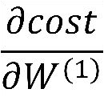
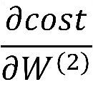
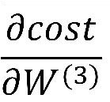
Back to backpropagation:
Want:
Rate of change of cost(or loss) with respect to training variables.
Measure of how fast loss is changing when you change a training variable (weight or biases).

Slide 36
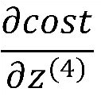
Back Propagation
_{a}(2)
_{a}(3)
_{a}(4)
_{W}(1)
_{W}(2)
_{W}(3)
σ
σ
x₁
SM
c o s t
σ
σ
x₂
SM
σ
σ
+1
SM
+1
+1
x_{i}: input value ŷ: output vector
σ: sigmoid (logistic) function SM: Softmax function
+1: bias (constant) unit
a^{(l)}: activation vector for layer l
W^{(l)}: weight matrix for layer l
_{z}(l):
input into layer l

Slide 37
Back Propagation
_{a}(2)
_{a}(3)
_{a}(4)
_{W}(1)
_{W}(2)
_{W}(3)
σ
σ
x₁
SM
c o s t
σ
σ
x₂
SM
σ
σ
+1
SM
+1
+1
x_{i}: input value ŷ: output vector
σ: sigmoid (logistic) function SM: Softmax function
+1: bias (constant) unit
a^{(l)}: activation vector for layer l
W^{(l)}: weight matrix for layer l
_{z}(l):
input into layer l

Slide 38
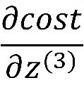
Back Propagation
_{a}(2)
_{a}(3)
_{a}(4)
_{W}(1)
_{W}(2)
_{W}(3)
σ
σ
x₁
SM
c o s t
σ
σ
x₂
SM
σ
σ
+1
SM
+1
+1
x_{i}: input value ŷ: output vector
σ: sigmoid (logistic) function SM: Softmax function
+1: bias (constant) unit
a^{(l)}: activation vector for layer l
W^{(l)}: weight matrix for layer l
_{z}(l):
input into layer l

Slide 39
Back Propagation
_{a}(2)
_{a}(3)
_{a}(4)
_{W}(1)
_{W}(2)
_{W}(3)
σ
σ
x₁
SM
c o s t
σ
σ
x₂
SM
σ
σ
+1
SM
+1
+1
x_{i}: input value ŷ: output vector
σ: sigmoid (logistic) function SM: Softmax function
+1: bias (constant) unit
a^{(l)}: activation vector for layer l
W^{(l)}: weight matrix for layer l
_{z}(l):
input into layer l

Slide 40

Back Propagation
_{a}(2)
_{a}(3)
_{a}(4)
_{W}(1)
_{W}(2)
_{W}(3)
σ
σ
x₁
SM
c o s t
σ
σ
x₂
SM
σ
σ
+1
SM
+1
+1
x_{i}: input value ŷ: output vector
σ: sigmoid (logistic) function SM: Softmax function
+1: bias (constant) unit
a^{(l)}: activation vector for layer l
W^{(l)}: weight matrix for layer l
_{z}(l):
input into layer l

Slide 41
Back Propagation
Want:
_{a}(2)
_{a}(3)
_{a}(4)
_{W}(1)
_{W}(2)
_{W}(3)
σ
σ
x₁
SM
c o s t
σ
σ
x₂
SM
σ
σ
+1
SM
+1
+1
x_{i}: input value ŷ: output vector
σ: sigmoid (logistic) function SM: Softmax function
+1: bias (constant) unit
a^{(l)}: activation vector for layer l
W^{(l)}: weight matrix for layer l
_{z}(l):
input into layer l

Slide 42
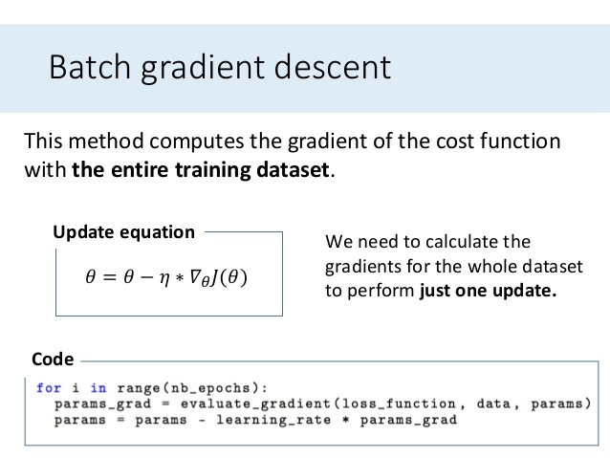
Updating trainable variables until convergence

Slide 43
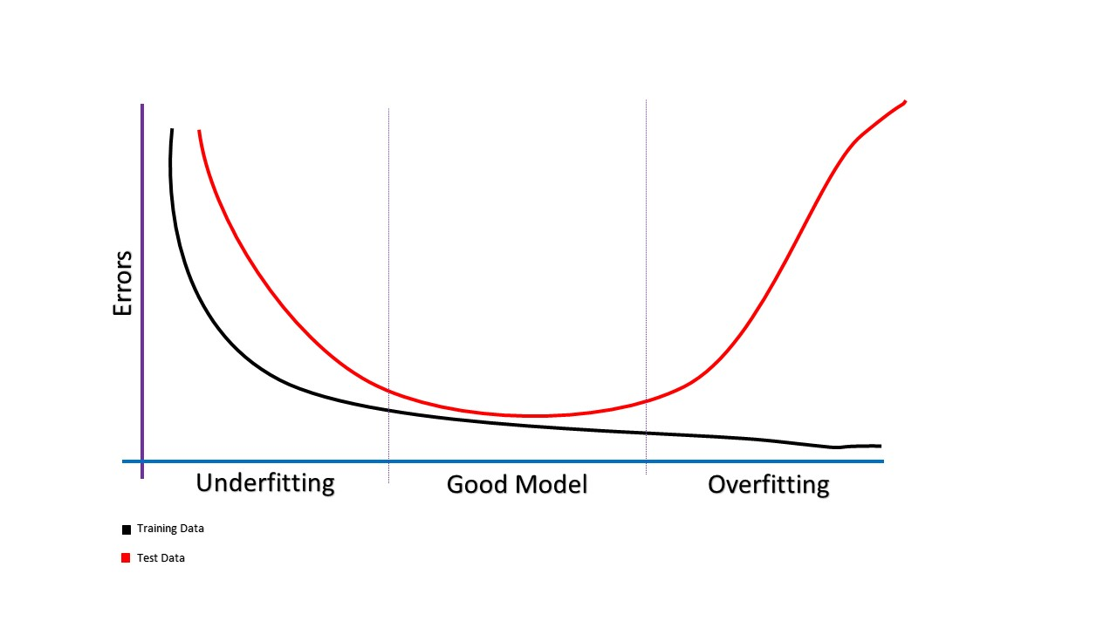
When to stop the training/change of complexity of the model ?
Underfitting – Validation and training error high
Good fit – Validation error low, slightly higher than the training error
Overfitting – Validation error is high, training error low

Slide 44

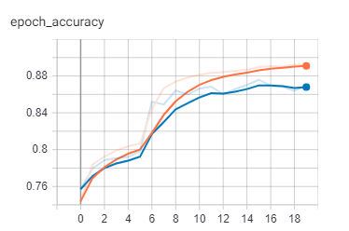
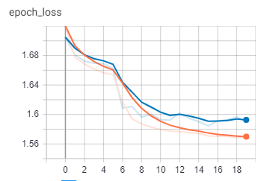
Using Tensor Board to view model metrics and evaluate the model
Taking a preloaded dataset(FMNIST) to show the metrics. It has images of size(28x28) categorized into 10 classes
model = Sequential()
model.add(Dense(512, activation='relu’),
input_shape=(28, 28))
model.add(Dense(10, activation='softmax'))
Good Enough model.
-> Train & val_accuracy is continuousy increasing
-> Train & val loss continuously decreasing, val loss should not increase for a model to be a good fit.

Slide 45
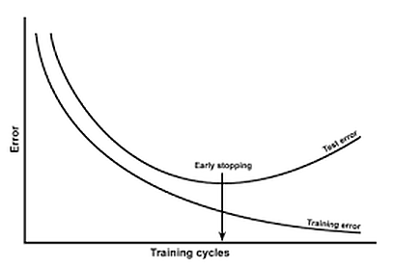
What can we do to reduce overfitting ?
1. Simplifying the model
First step when dealing with overfitting is to decrease the complexity of the model. To decrease the complexity, we can simply remove layers or reduce the number of neurons to make the network smaller.
2.Run the training only for optimal number of epochs (Early Stopping)

Slide 46
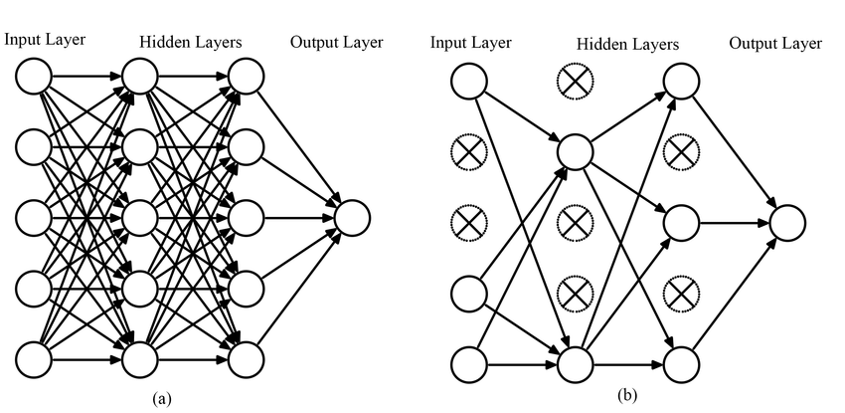
What can we do to reduce overfitting ?
3.Try Adding a dropout layer
Dropout(0.5)
Dropout Layer randomly drops neurons from the neural network during training in each iteration.

Slide 47
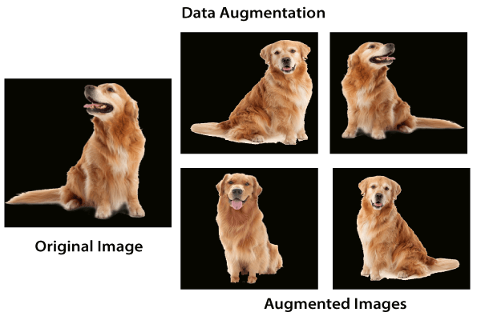
What can we do to reduce overfitting ?
4.Data Augmentation
In the case of neural networks, data augmentation simply means increasing size of the data that is increasing the number of images present in the dataset. Some of the popular image augmentation techniques are flipping, translation, rotation, scaling, changing brightness, adding noise etc.

Slide 48
Thank You

